Slide 1




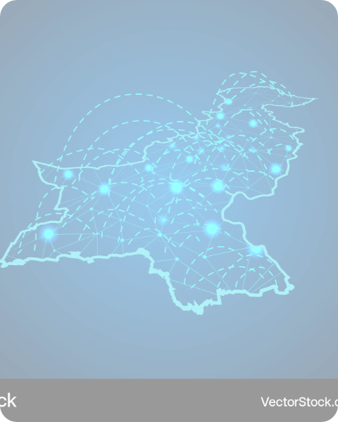




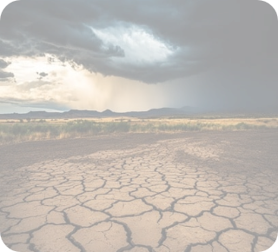
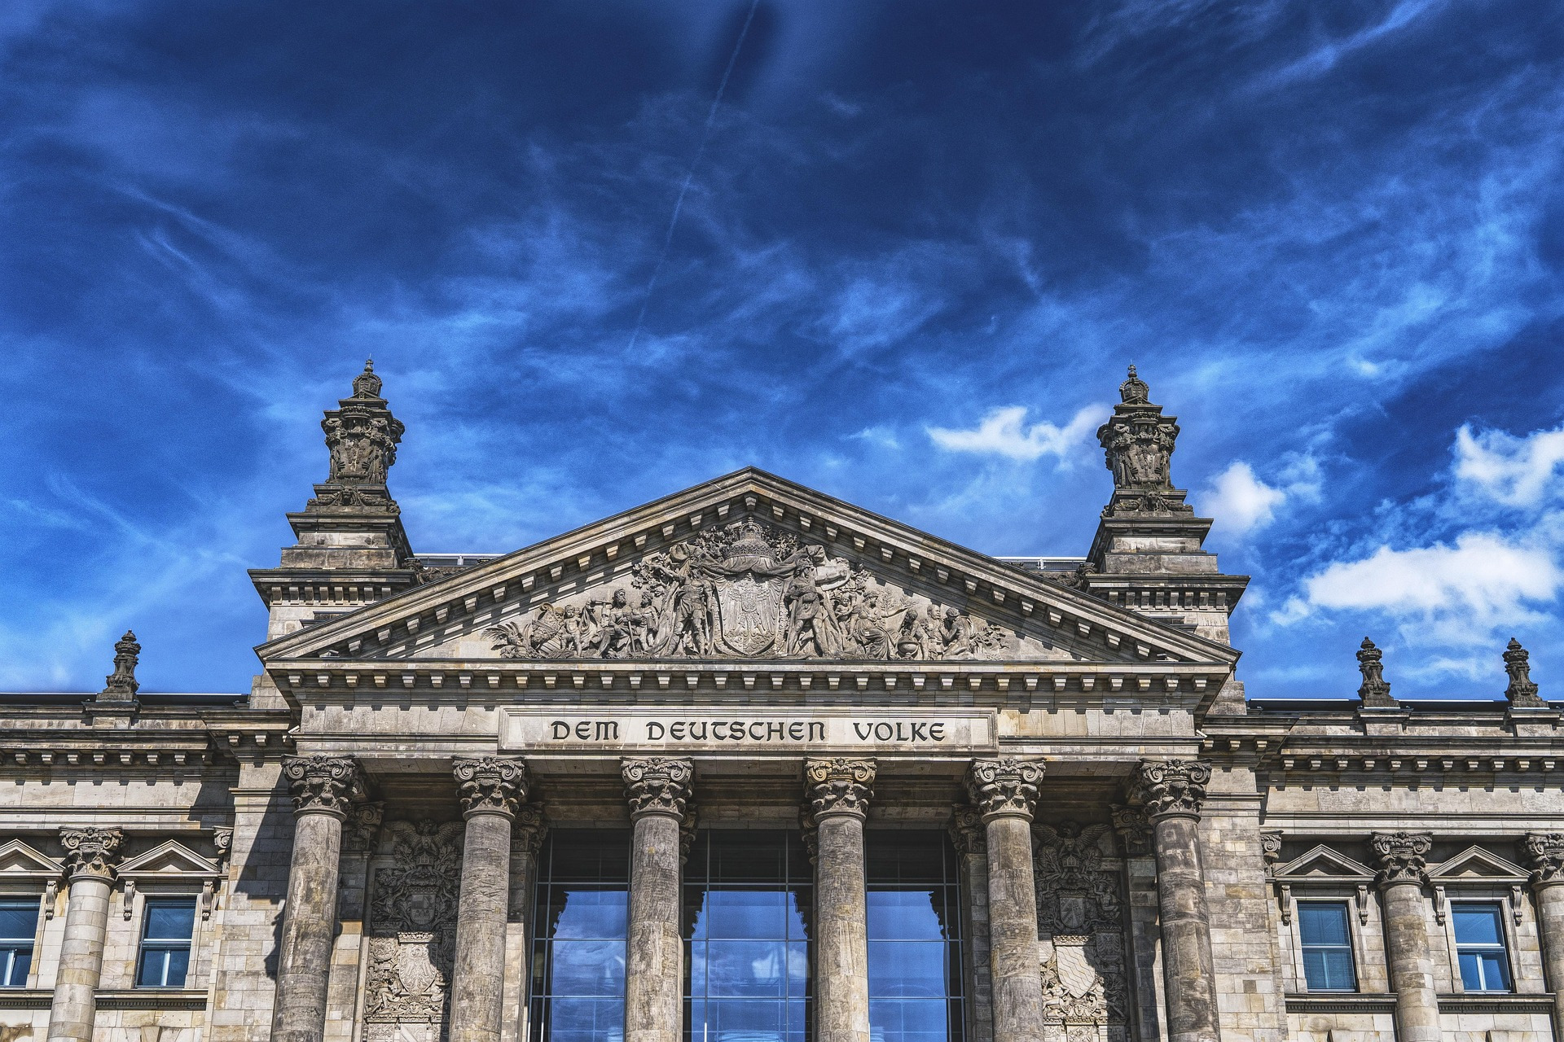
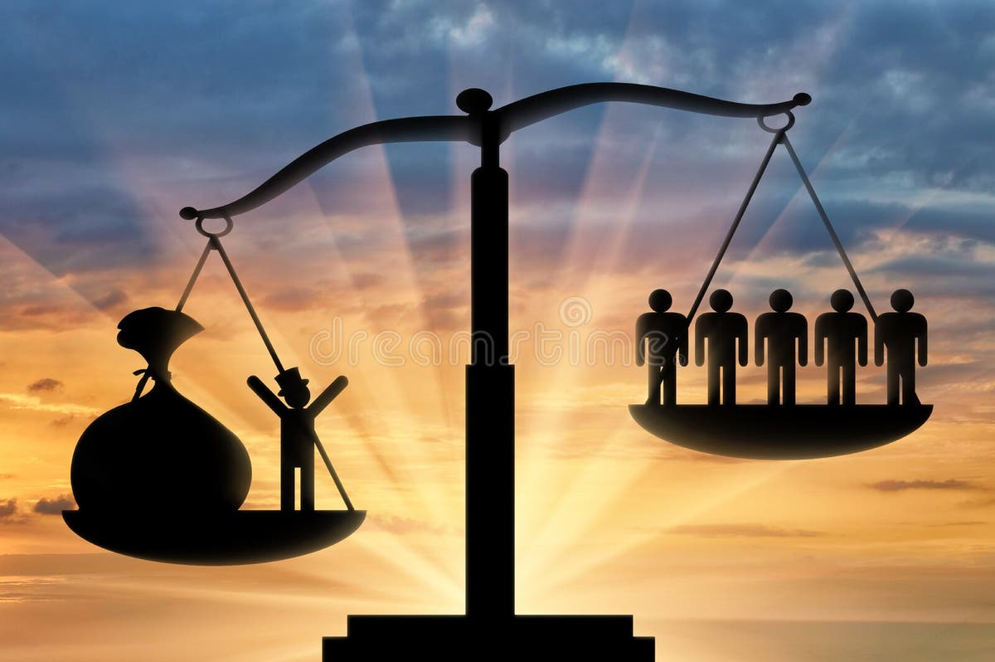
Pakistan's
Strategic
Horizon 2025
Muhammad Aliyan
Abdul Mateen
Terrorism &
Extremism
Hybrid
Warfare
Hybrid
Warfare
A comprehensive analysis of the critical security, economic, and social challenges shaping the future.
Noor Fatima &
Wajiha Eman
Arooba Naeem
Climate
Change
Governance &
Inequality

Slide 2
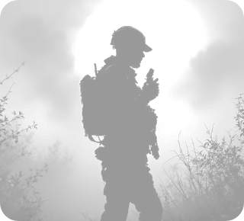
Terrorism &
Extremism
Muhammad Aliyan
The Statistical Escalation of Violence
The quantitative data regarding terrorism in Pakistan for the 2024-2025 period indicates a profound escalation in violence, challenging the state's monopoly on force in critical regions. According to the Global Terrorism Index (GTI) 2025, Pakistan remained among the countries most impacted by terrorism globally. The lethality of the operational environment is underscored by the presence of three of the world's four deadliest terrorist groups—Islamic State (IS), Jamaat Nusrat Al-Islam wal Muslimeen (JNIM), and the Tehrik-e-Taliban Pakistan (TTP)—active within or near its borders.

Slide 3
Terrorism &
Extremism
Muhammad Aliyan
The Statistical Escalation of Violence
In 2024 alone, Pakistan experienced a 70% increase in terrorist attacks compared to the previous year, totalling 521 incidents. This surge is not merely numerical but reflects an intensification of violence, with fatalities rising to 1,950 individuals. The violence in 2025 continued this upward trajectory, with reports from the first quarter of 2025 indicating nearly 300 attacks in Khyber Pakhtunkhwa alone. This incredible density of attacks in a single province suggests that militant groups have moved beyond hit-and-run tactics to establishing a persistent operational tempo that challenges the state's writ.

Slide 4
Terrorism &
Extremism
Muhammad Aliyan
The TTP and IS-K: A Dual-Front War
The Tehrik-e-Taliban Pakistan (TTP) has emerged as the "fastest-growing terrorist group" globally in terms of lethality, with a 90% increase in attributed deaths in 2024. This resurgence is not accidental but structural. The group has successfully exploited the strategic depth provided by the Afghan hinterland to reorganize, re-equip, and launch sustained campaigns against the Pakistani state. The TTP’s operational focus has shifted from indiscriminate civilian attacks to precision strikes against the security apparatus, aiming to demoralize the police and military forces stationed in the tribal districts.

Slide 5
Terrorism &
Extremism
Muhammad Aliyan
The TTP and IS-K: A Dual-Front War
Simultaneously, the Islamic State (IS), particularly its Khorasan chapter (IS-K), has expanded its footprint. In 2024, IS and its affiliates were responsible for 1,805 deaths across 22 countries, with Pakistan being a primary theatre of operation alongside Syria and the DRC. The interplay between the TTP and IS-K presents a complex threat matrix. While TTP focuses on the state and security forces—evidenced by the suicide bombing on a police mosque in Peshawar that killed 95 people, mostly police personnel —IS-K has targeted political and sectarian fault lines. The IS-K claimed responsibility for a suicide attack on a JUI-F political rally in Bajaur, killing over 50 people, and continues to target religious minorities. This division of labour—TTP attacking the "hard" state and IS-K attacking "soft" societal targets—creates a pincer movement that stretches the state's counter-terrorism capacity to its breaking point.

Slide 6
The TTP and IS-K: A Dual-Front War
Simultaneously, the Islamic State (IS), particularly its Khorasan chapter (IS-K), has expanded its footprint. In 2024, IS and its affiliates were responsible for 1,805 deaths across 22 countries, with Pakistan being a primary theatre of operation alongside Syria and the DRC. The interplay between the TTP and IS-K presents a complex threat matrix. While TTP focuses on the state and security forces—evidenced by the suicide bombing on a police mosque in Peshawar that killed 95 people, mostly police personnel —IS-K has targeted political and sectarian fault lines. The IS-K claimed responsibility for a suicide attack on a JUI-F political rally in Bajaur, killing over 50 people, and continues to target religious minorities. This division of labour—TTP attacking the "hard" state and IS-K attacking "soft" societal targets—creates a pincer movement that stretches the state's counter-terrorism capacity to its breaking point.
Terrorism &
Extremism
Muhammad Aliyan
Geographic Concentration
The distribution of violence in 2024-2025 was highly asymmetric, concentrating heavily on the western border provinces of Khyber Pakhtunkhwa (KP) and Balochistan. These regions have effectively transformed into active conflict zones, distinct from the relative calm of the eastern provinces, although spillover is increasing.
Khyber Pakhtunkhwa
The province experienced a 69% increase in terrorist incidents in 2024. The intensity of the conflict here is defined by direct engagements between militants and the military. In September 2023, TTP launched coordinated, large-scale attacks on military checkpoints in Chitral, a tactic that became more frequent throughout 2024. The sheer volume of attacks in early 2025—nearly 300 in a few months—indicates that parts of the province are contesting the state's effective control.

Slide 7
Terrorism &
Extremism
Muhammad Aliyan
Balochistan
The security situation in Balochistan deteriorated even more sharply than in KP, registering an 84% upsurge in terrorist incidents in 2024. The violence here is driven by a convergence of the ethno-nationalist Baloch Liberation Army (BLA) and Islamist militancy. The province witnessed devastating attacks on civilian gatherings, such as the suicide bombing in Mastung during a religious which killed at least 60 people. This dual threat of separatist insurgency and religious extremism creates a volatile mix that hampers all development initiatives, including CPEC projects, in the region.
Other Provinces
While KP and Balochistan bore the brunt, Punjab also experienced an 83% upsurge in terrorist violence in 2024, albeit from a much lower base. This "bleed effect" suggests that the containment ring around the border zones is porous, and sleeper cells retain the capability to strike in the heartland. Conversely, Sindh recorded a 20% decline in incidents, the only province to show improvement.

Slide 8
The Hybrid Front
Abdul Mateen
The Cyber Siege
Hybrid warfare combines military and non-military strategies, information, cyberattacks, economy, and diplomacy to weaken an opponent without full-scale war. Pakistan faces these threats from both state and non-state actors.
Information & Psychological Warfare
The information domain is used to damage national unity and international image. Tactics include:
•Spreading fake news on social media to create confusion.
•Propaganda campaigns targeting the Armed Forces and nuclear programs.
•Promoting sectarian and ethnic hatred to divide society.
This directly targets public perception, morale, and Pakistan’s global reputation.

Slide 9
The Hybrid Front
Abdul Mateen
Cyber Warfare
•Targeting Pakistan’s financial stability by influencing global markets.
•Supporting anti-economic narratives to damage business confidence.
Economic Warfare
•Targeting financial stability by influencing global markets.
•Using advanced surveillance to monitor and slow down Pakistan’s technological growth.
Tech Warfare
•Use of advanced surveillance to monitor Pakistan.
•Attempts to slow down Pakistan’s technological growth.

Slide 10
Geographic Concentration
While KP and Balochistan bore the brunt, Punjab also experienced an 83% upsurge in terrorist violence in 2024, albeit from a much lower base. This "bleed effect" suggests that the containment ring around the border zones is porous, and sleeper cells retain the capability to strike in the heartland. Conversely, Sindh recorded a 20% decline in incidents, the only province to show improvement.
The Hybrid Front
Abdul Mateen
Strategic Solutions
•Strengthen Information Defence
Create a national digital media monitoring system and penalize deliberate misinformation.
•Improve Cybersecurity
Establish a National Cyber Command and upgrade infrastructure.
•Internal Stability
Improve development in Balochistan and KP to reduce grievances.
•Economic Resilience
Expand CPEC and promote exports to reduce vulnerability.
•Improve National Awareness
Conduct public awareness campaigns on media literacy. Train government officials, journalists, and students in national security awareness
The Cyber Siege
In the first three quarters of 2025 alone, over 5.3 million on-device attacks were detected in Pakistan. The scope of these attacks was broad, affecting 27% of all individual users and 24% of corporate entities. The vectors included physical compromise through infected USB drives, CDs, and DVDs, delivering payloads such as ransomware, worms, backdoors, and spyware. Web-based attacks were even more prevalent, with 2.5 million incidents blocked by cybersecurity firms in the same period.
MEMBER 03
Climate
Change

Slide 11
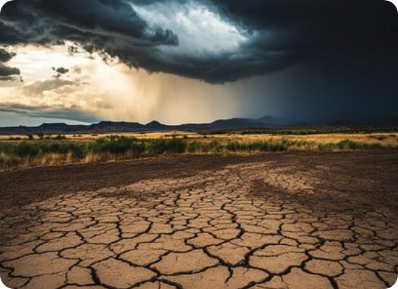
Climate Change in Pakistan: A Nation on the Frontline
Arooba Naeem
How Climate Change is Affecting Pakistan
Pakistan, despite contributing less than 1% to global greenhouse gas emissions, is one of the country's most vulnerable to the impacts of climate change. Its geography, heavy reliance on agriculture and water from glacial systems, and socioeconomic challenges make it highly susceptible to climate shifts, transforming it into a case study of climate.
The effects of Climate Change in Pakistan are no longer a future threat; they are a present and intensifying reality. Climate change is already a clear and dangerous reality in Pakistan, seen through five main disasters:
A. Melting Glaciers and Water Scarcity
The Indus River System:
The Indus River System is a network of rivers, primarily fed by the glaciers in the Hindu Kush, Karakoram, and Himalayan ranges, that forms the hydrological backbone of Pakistan. It is essential for the country’s water supply, agriculture, economy, and food security.
Accelerated Melting:
Rising temperatures are causing these glaciers to melt at a much faster rate than the normal rate. This accelerated melting creates a two-stage crisis:
Short-Term Impact: Too much Water (Floods) The massive amount of meltwater, combined with heavy monsoon rains, overwhelms rivers, causing devastating floods (like those recently and in 2022).
Long-Term Impact: Too Little Water (Scarcity) Glaciers act as “natural water towers” that store water in winter and release in summer. As they shrink and disappear, this steady water supply vanishes. This leads to a permanent water shortage for rivers like Indus.

Slide 12
Climate Change in Pakistan: A Nation on the Frontline
Arooba Naeem
A. Melting Glaciers and Water Scarcity
The Indus River System:
The Indus River System is a network of rivers, primarily fed by the glaciers in the Hindu Kush, Karakoram, and Himalayan ranges, that forms the hydrological backbone of Pakistan. It is essential for the country’s water supply, agriculture, economy, and food security.
B. Intensified Monsoon Rains and Flooding
The 2022 Super floods:
A prime example of this intensification, the 2022 monsoon season brought catastrophic floods that submerged a third of the country, affecting the 33 million people, and causing over $30 billion in damages.
Warmer oceans:
A warmer Arabian Sea leads to great evaporation, super changing the monsoon system and leading to more intense and erratic
rainfall patterns, overwhelming river systems and causing widespread riverine and urban flooding.
Accelerated Melting:
Rising temperatures are causing these glaciers to melt at a much faster rate than the normal rate. This accelerated melting creates a two-stage crisis:
Short-Term Impact: Too much Water (Floods) The massive amount of meltwater, combined with heavy monsoon rains, overwhelms rivers, causing devastating floods (like those recently and in 2022).
Long-Term Impact: Too Little Water (Scarcity) Glaciers act as “natural water towers” that store water in winter and release in summer. As they shrink and disappear, this steady water supply vanishes. This leads to a permanent water shortage for rivers like Indus.

Slide 13
Climate Change in Pakistan: A Nation on the Frontline
Arooba Naeem
B. Intensified Monsoon Rains and Flooding
The 2022 Super floods:
A prime example of this intensification, the 2022 monsoon season brought catastrophic floods that submerged a third of the country, affecting the 33 million people, and causing over $30 billion in damages.
Warmer oceans:
A warmer Arabian Sea leads to great evaporation, super changing the monsoon system and leading to more intense and erratic rainfall patterns, overwhelming river systems and causing widespread riverine and urban flooding.
C. Increased Frequency and Severity of Heatwaves:
Record-Breaking Temperatures:
Pakistan regularly experiences some of the highest temperatures in the world. Cities like Jacobabad surpassed 52°C (126°F).
Health and Livelihood Impacts:
Extreme heat poses severe to public health, leads to heat stroke deaths, reduces and damages crops, labour productivity, exacerbating food insecurity.
C. Increased Frequency and Severity of Heatwaves:
Record-Breaking Temperatures:
Pakistan regularly experiences some of the highest temperatures in the world. Cities like Jacobabad surpassed 52°C (126°F).
Health and Livelihood Impacts:
Extreme heat poses severe to public health, leads to heat stroke deaths, reduces and damages crops, labour productivity, exacerbating food insecurity.

Slide 14
Climate Change in Pakistan: A Nation on the Frontline
Arooba Naeem
Key Vulnerabilities and Contributing Factors:
Several factors exacerbate Pakistan’s susceptibility to climate change.
Agricultural Dependence:
A large portion of the population and economy is tied to climate-sensitive agriculture.
Rapid population growth and Urbanization:
This puts immense pressure on limited natural resources and infrastructure, which is often unable to cope with extreme weather events.
Lack of Infrastructure:
Weak Infrastructure: Inadequate drainage, poor water management systems, and non-resilient housing make the population highly vulnerable to floods and heatwaves.
Socioeconomic Challenges:
High poverty levels limit the adaptive capacity of individuals and communities, forcing them to live in high-risk areas.
National Response and Key Initiatives:
Recognizing the severity of the threat, Pakistan has limited several policies and projects.
National Climate Change Policy (NCCP):
Provides a comprehensive framework for addressing climate change, focusing on both adaption and mitigation.
Pakistan’s Nationally Determined Contributions (NDCs):
As part of the Paris Agreement, Pakistan has committed to reducing it greenhouse gas emissions by 50% by 2030, conditional on international finance.
The Living Indus Initiative:
A major project focused on the ecological restoration of the Indus River Basin, which is critical for the country’s water, food, and environmental security.
The Ten Billion Tre Tsunami Programme:
A flagship afforestation project aimed at restoring degraded forests, reducing Carbon, and creating green jobs.
Early Warning Systems:
Efforts are underway to improve meteorological forecasting and early warning systems for floods and cyclones.

Slide 15
Climate Change in Pakistan: A Nation on the Frontline
Arooba Naeem
National Response and Key Initiatives:
Recognizing the severity of the threat, Pakistan has limited several policies and projects.
National Climate Change Policy (NCCP):
Provides a comprehensive framework for addressing climate change, focusing on both adaption and mitigation.
Pakistan’s Nationally Determined Contributions (NDCs):
As part of the Paris Agreement, Pakistan has committed to reducing it greenhouse gas emissions by 50% by 2030, conditional on international finance.
The Living Indus Initiative:
A major project focused on the ecological restoration of the Indus River Basin, which is critical for the country’s water, food, and environmental security.
The Ten Billion Tre Tsunami Programme:
A flagship afforestation project aimed at restoring degraded forests, reducing Carbon, and creating green jobs.
Early Warning Systems:
Efforts are underway to improve meteorological forecasting and early warning systems for floods
The way Forward: Challenges and Recommendations:
Addressing climate change in Pakistan requires a multi-pronged approach:
Prioritize Adaptation:
Investing in climate-resilient infrastructure, drought-resistant crops, efficient irrigation, and early warning systems is crucial Integrated Water Resource Management:
Modernizing water governance, building water storage capacity, and promoting water conservation are essential to managing both floods and droughts.
Mainstreaming Climate Change:
Climate considerations must be integrated into all national planning, from agriculture and urban development to energy and health.
Access to International Climate Finance:
Pakistan urgently needs access to grants and concessional finance from international mechanism like Green Climate Fund to implement its ambitious climate lans.

Slide 16
Climate Change in Pakistan: A Nation on the Frontline
Arooba Naeem
The way Forward: Challenges and Recommendations:
Addressing climate change in Pakistan requires a multi-pronged approach:
Prioritize Adaptation:
Investing in climate-resilient infrastructure, drought-resistant crops, efficient irrigation, and early warning systems is crucial Integrated Water Resource Management:
Modernizing water governance, building water storage capacity, and promoting water conservation are essential to managing both floods and droughts.
Mainstreaming Climate Change:
Climate considerations must be integrated into all national planning, from agriculture and urban development to energy and health.
Access to International Climate Finance:
Pakistan urgently needs access to grants and concessional finance from international mechanism like Green Climate Fund to implement its ambitious climate lans.
Conclusion:
Pakistan stands at a critical juncture. The country is experiencing more extreme weather, from devastating floods to unbearable heatwaves and droughts. This is happening because the world is getting warmer, and Pakistan is suffering the effects despite contributing very little to the problem. This crisis threatens the nation’s food supply, water security, and the livelihoods of millions of people. To survive, Pakistan must urgently built stronger defences, manage its water wisely, and adapt farming practices that can with stand harsh weather. At the same time, the international community must provide support and funding, as they bear greater responsibility for causing this global problem. Ultimately, tackling this challenge requires efforts from everyone—the government, local communities, and all citizens to secure a safer future.

Slide 17
Foundational Instability & First Martial Law (1947–1969)
Early Challenges:
The new state faced a leadership vacuum, refugee crises, and no constitution (1947–1956). leadership changed frequently; Prime Ministers rarely lasted more than a few months, and Governor Generals were also replaced.
1958 Coup:
Political conflict led General Ayub Khan to impose the first Martial Law, dismissing the 1956 Constitution
Ayub Era:
Brought economic growth (Green Revolution) and the 1962 Constitution but suppressed political freedom,
Problems and Protests:
Despite economic gains, the populace lacked political freedom, and East Pakistan felt neglected or ignored. This resulted in protests led by students and the opposition.
Transfer of Power:
When opposition intensified, Ayub Khan transferred power to General Yahya Khan in 1969.
Climate Change in Pakistan: A Nation on the Frontline
Arooba Naeem
Conclusion:
Pakistan stands at a critical juncture. The country is experiencing more extreme weather, from devastating floods to unbearable heatwaves and droughts. This is happening because the world is getting warmer, and Pakistan is suffering the effects despite contributing very little to the problem. This crisis threatens the nation’s food supply, water security, and the livelihoods of millions of people. To survive, Pakistan must urgently built stronger defences, manage its water wisely, and adapt farming practices that can with stand harsh weather. At the same time, the international community must provide support and funding, as they bear greater responsibility for causing this global problem. Ultimately, tackling this challenge requires efforts from everyone—the government, local communities, and all citizens to secure a safer future.

Slide 18
Political History and Governance Crisis in Pakistan
Noor Fatima
Foundational Instability & First Martial Law (1947–1969)
Early Challenges:
The new state faced a leadership vacuum, refugee crises, and no constitution (1947–1956). leadership changed frequently; Prime Ministers rarely lasted more than a few months, and Governor Generals were also replaced.
1958 Coup:
Political conflict led General Ayub Khan to impose the first Martial Law, dismissing the 1956 Constitution
Ayub Era:
Brought economic growth (Green Revolution) and the 1962 Constitution but suppressed political freedom.
Problems and Protests:
Despite economic gains, the populace lacked political freedom, and East Pakistan felt neglected or ignored. This resulted in protests led by students and the opposition.
Transfer of Power:
When opposition intensified, Ayub Khan transferred power to General Yahya Khan in 1969.
Disintegration, Reconstruction & Zia Era (1969–1988)
Fall of Dhaka:
Free elections were announced in 1970. The Awami League won in East Pakistan, while the PPP won in West Pakistan. Despite the Awami League holding the majority, power was not transferred. This decision caused protests, clashes, and military action. Led to the separation of East Pakistan (Bangladesh) in 1971.
The Bhutto Era:
Zulfiqar Ali Bhutto introduced the landmark 1973 He implemented economic reforms, pursued nationalization policies, and strengthened foreign policy. Crucially, he introduced the 1973 Constitution, which remains the foundational legal structure today. In 1977, General Zia-ul-Haq imposed martial law, arresting Bhutto, who was later executed. Fazal Ilahi Chaudhry was the President during this time.
.

Slide 19
Political History and Governance Crisis in Pakistan
Noor Fatima
Disintegration, Reconstruction & Zia Era (1969–1988)
Zia-ul-Haq:
Zia's era is the longest military rule in Pakistan's history.
Policies: Key aspects included Islamization policies, tough actions against the opposition, and control over newspapers. The economy experienced some stabilization, partly due Afghanistan war.
Elections: Non-party elections were held in 1985. Zia-ul-Haq was President.
1988: Zia died in a plane crash, after which the political system moved back toward democracy..
Disintegration, Reconstruction & Zia Era (1969–1988)
Fall of Dhaka:
Free elections were announced in 1970. The Awami League won in East Pakistan, while the PPP won in West Pakistan. Despite the Awami League holding the majority, power was not transferred. This decision caused protests, clashes, and military action. Led to the separation of East Pakistan (Bangladesh) in 1971.
Bhutto Era
Zulfiqar Ali Bhutto introduced the landmark 1973 He implemented economic reforms, pursued nationalization policies, and strengthened foreign policy. Crucially, he introduced the 1973 Constitution, which remains the foundational legal structure today. In 1977, General Zia-ul-Haq imposed martial law, arresting Bhutto, who was later executed. Fazal Ilahi Chaudhry was the President during this time.

Slide 20
Political History and Governance Crisis in Pakistan
Noor Fatima
Disintegration, Reconstruction & Zia Era (1969–1988)
Zia-ul-Haq:
Zia's era is the longest military rule in Pakistan's history.
Policies: Key aspects included Islamization policies, tough actions against the opposition, and control over newspapers. The economy experienced some stabilization, partly due Afghanistan war.
Elections: Non-party elections were held in 1985. Zia-ul-Haq was President.
1988: Zia died in a plane crash, after which the political system moved back toward democracy.
Political Volatility & The Musharraf Era (1988–2008)
The 1990s "Musical Chairs“:
This period was characterized by conflicts between the executive (PM) and the presidency, often backed by the army, leading to repeated dismissals.
Benazir Bhutto (2 Terms):
First female Muslim PM. Her governments (1988–90, 1993–96) were dismissed by Presidents Ghulam Ishaq Khan and Farooq Leghari due to corruption allegations and establishment friction.
Nawaz Sharif (2 Terms):
Focused on infrastructure (Motorways) and nuclear tests. His governments (1990–93, 1997–99) faced similar dismissals. His attempt to check military power led to his ouster in 1999.
The Musharraf Regime (1999–2008):
He held dual roles (President & Army Chief), liberalized the media, and oversaw initial economic growth. the Lal Masjid operation, and the 2007 Emergency weakened his grip, leading to his resignation in 2008.

Slide 21
Political History and Governance Crisis in Pakistan
Noor Fatima
Political Volatility & The Musharraf Era (1988–2008)
The 1990s "Musical Chairs“:
This period was characterized by conflicts between the executive (PM) and the presidency, often backed by the army, leading to repeated dismissals.
Benazir Bhutto (2 Terms):
First female Muslim PM. Her governments (1988–90, 1993–96) were dismissed by Presidents Ghulam Ishaq Khan and Farooq Leghari due to corruption allegations and establishment friction.
Nawaz Sharif (2 Terms):
Focused on infrastructure (Motorways) and nuclear tests. His governments (1990–93, 1997–99) faced similar dismissals. His attempt to check military power led to his ouster in 1999.
The Musharraf Regime (1999–2008):
He held dual roles (President & Army Chief), liberalized the media, and oversaw initial economic growth. the Lal Masjid operation, and the 2007 Emergency weakened his grip, leading to his resignation in 2008.
The Modern Democratic Cycle
(2008–2025)
President Asif Ali Zardari; PMs Yousaf Raza Gillani & Raja Pervaiz Ashraf Restored the 1973 Constitution's parliamentary spirit but faced security challenges.
PML-N Government (2013–2018):
PM Nawaz Sharif (later Shahid Khaqan Abbasi) Focused on CPEC and energy projects. Nawaz Sharif was disqualified by the courts before completing his term.
PTI Government (2018–2022):
PM Imran Khan Focused on accountability and social welfare. Removed via a Vote of No Confidence in 2022 amid economic turmoil.
Coalition & Current Setup (2022–2025):
Leadership: PM Shehbaz Sharif (PDM Coalition, then 2024 elections). A period marked by severe economic crisis (inflation) and political polarization.

Slide 22
Political History and Governance Crisis in Pakistan
Noor Fatima
The Modern Democratic Cycle
(2008–2025)
President Asif Ali Zardari; PMs Yousaf Raza Gillani & Raja Pervaiz Ashraf Restored the 1973 Constitution's parliamentary spirit but faced security challenges.
PML-N Government (2013–2018):
PM Nawaz Sharif (later Shahid Khaqan Abbasi) Focused on CPEC and energy projects. Nawaz Sharif was disqualified by the courts before completing his term.
PTI Government (2018–2022):
PM Imran Khan Focused on accountability and social welfare. Removed via a Vote of No Confidence in 2022 amid economic turmoil.
Coalition & Current Setup (2022–2025):
Leadership: PM Shehbaz Sharif (PDM Coalition, then 2024 elections). A period marked by severe economic crisis (inflation) and political polarization.
Reasons of Governance crisis:
• Unnecessary military interference in government matters
• Political leaders more interested in gaining and holding power
• Corruption and misuse of public resources
• Frequent conflicts between military and civilian governments
• Weak democratic institutions and lack of accountability
Effects of Crisis of Governance in Pakistan
• Slow economic growth
• Poor education and health systems
• Rising corruption
• Lack of rule of law
• Public dissatisfaction and protests
• Weak democracy
• Poor global image of Pakistan

Slide 23
Political History and Governance Crisis in Pakistan
Noor Fatima
Reasons of Governance crisis:
• Unnecessary military interference in government matters
• Political leaders more interested in gaining and holding power
• Corruption and misuse of public resources
• Frequent conflicts between military and civilian governments
• Weak democratic institutions and lack of accountability
Effects of Crisis of Governance in Pakistan
• Slow economic growth
• Poor education and health systems
• Rising corruption
• Lack of rule of law
• Public dissatisfaction and protests
• Weak democracy
• Poor global image of Pakistan

Slide 24

Socio-Economic Inequality in Pakistan
Wajiha Eman
Main Aspects of Socio-Economic Inequality in Pakistan
In Pakistan, socio-economic inequality is visible in the unequal distribution of income, education, healthcare, and opportunities among different regions, genders, and social classes.
1. Income Inequality
•A small percentage of Pakistanis (industrialists, politicians, business owners) hold most wealth.
•Millions of people live below the poverty line, struggling for necessities like food, water, and electricity.
•Example: Urban elites in Karachi or Lahore earn millions, while rural farmers in Sindh or Balochistan earn very little.

Slide 25
Socio-Economic Inequality in Pakistan
Wajiha Eman
2. Education Inequality
•Private schools in urban areas provide high-quality education.
•Public schools, especially in rural areas, suffer from poor infrastructure, lack of teachers, and outdated curricula.
•Many children, especially girls, drop out due to poverty, child labour, or cultural barriers.
3. Health Inequality
•Wealthy people go to private hospitals like Aga Khan or Shaukat Khanum.
•Poor people depend on government hospitals that often lack medicines, equipment, and specialists.
•Rural areas face extreme shortages of healthcare facilities.
4. Job Opportunities
•Urban centres have more job opportunities in IT, banking, industry, and services.
•Rural areas depend on agriculture and informal jobs, which are low-paying and seasonal.

Slide 26
Socio-Economic Inequality in Pakistan
Wajiha Eman
5. Living Conditions
•Elite neighbourhoods have clean water, electricity, and security.
•Slums in big cities and villages in remote areas face poor sanitation, unsafe housing, and lack of clean water.
6. Gender Inequality
•Women have lower literacy rates and fewer job opportunities.
•Cultural norms in some areas restrict women’s mobility and decision-making.
•Example: In rural Sindh or Balochistan, many girls are married young and cannot continue education.
7. Regional Opportunities
•Punjab and urban Sindh are more developed.
•Balochistan and northern rural areas have fewer schools, hospitals, and roads.
•This creates migration to cities, overcrowding, and pressure on urban services.

Slide 27
Socio-Economic Inequality in Pakistan
Wajiha Eman
Causes of Inequality
•Unequal access to quality education.
•Concentration of wealth among elites.
•Poor government policies and corruption.
•Lack of industrialization and job opportunities in rural areas.
•Gender discrimination limits women’s contribution.
•Political instability and weak governance.
Effects in Pakistan
•Extreme poverty rate: Millions live on less than $2 a day.
•Poor health and nutrition: Malnutrition and infant mortality are high in rural areas.
•Crime and unrest: Economic frustration leads to theft, gang violence, and protests.
•Slow economic growth: Inequality limits human capital and productivity.
•Social divisions: Tensions between rich and poor, urban vs rural, and different provinces.

Slide 28
Socio-Economic Inequality in Pakistan
Wajiha Eman
Conclusion
In Pakistan, socio-economic inequality is a severe problem because wealth, education, healthcare, and jobs are not evenly distributed. Urban elites thrive while rural populations and women often struggle. Addressing these issues requires better governance, education reforms, healthcare access, and policies for fair wealth distribution.

